Slide 1
Estimate British Pound Volatility using NLP and LSTM Neural Network
DURING THE BREXIT PERIOD
CRISTOBAL GONZALEZ
DENIZ KURAL

Slide 2
CONTENTS
Student Information & Introduction
Problem Statement
Datasets Used for the Project
“GBP Index Price” Dataset
“Brexit Tweets” Dataset
Natural Language Processing for Tweets
Preprocessing
Sentiment Analysis (VADER)
Volatility Prediction using LSTM Model
Conclusion & Future Work

Slide 3
Student Information & Introduction
Student Information
Deniz Kural / Email: dk3703@nyu.edu
Cristobal Gonzalez Corssen / Email: cg3516@nyu.edu
Motivation: To estimate GBP’s volatility with a considerable accuracy by using the news (Tweets) related to the trade talks.
Steps for achieving task:
Twitter API scraping for getting Tweets from Twitter,
NLP modeling,
Generating the sentiment scores for individual tweets
Prediction of GBP’s volatility with LSTM model.

Slide 4
Problem Statement
Volatility as prediction target.
Its features of clustering and mean reversion, makes us believe that it easier to predict than prices.
Trying to estimate the volatility of a foreign exchange rate, considering the historical prices and news related to the country.
The problem consists in a little more than three years of data as the Brexit originates in mid 2016.

Slide 5
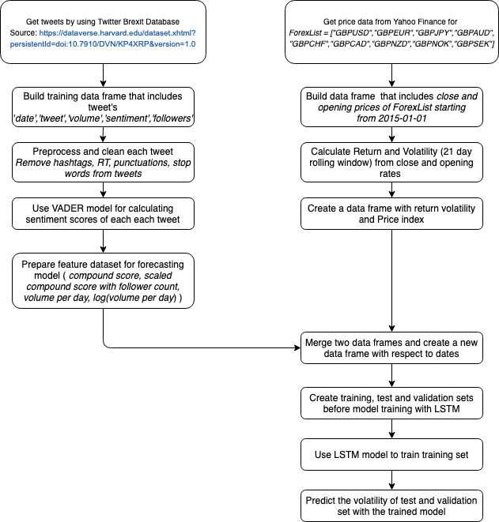
Figure 1: Flow Chart for Project

Slide 6
Datasets Used for the Project
“GBP Index Price” Dataset
The purpose: Isolate the movements of this particular country currency with respect to others.
Compare the Great Britain Pound against the G10 currencies,
GBPUSD, GBPEUR, GBPJPY, GBPAUD, GBPNZD, GBPCAD, GBPCHF, GBPNOK, and GBPSEK.
The goal was to create an index that were equivalent to have a portfolio of different currencies.
“Brexit Tweets” Dataset
Twitter API was used to extract the Tweets.
Brexit Dataset from Harvard Dataverse
Contains the public tweets about Brexit, posted between Jan 2016 and September 2019. (the number of lines in the tweet list is 50,897,534.)
ID of tweet and user, Sentiment of Tweet, Stance of Tweet
280,000 tweets fetched (App. 200 per day) -- 56 hours of downloading!

Slide 7
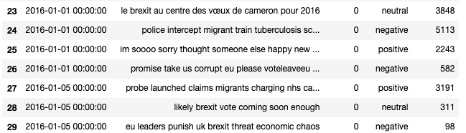
Natural Language Processing
Preprocessing
Normalize all characters to be lower-case across all our data
URLs and usernames are removed from the tweet
The number sign (i.e. #) is removed from every hashtag
Replace 2 or more dots (.) and 2 or more spaces with a single space
Duplicate characters are rid of from their respective word in the tweet
Replaced all the URLs in tweets with the word URL and replace all @USER with AT_USER and then remove
Stopwords are removed (ex: the, at, a, an, he, etc.)
Tweet Text Preprocessing

Slide 8
Natural Language Processing
VADER Sentiment Model
Need: Not the binary polarity (positive versus negative), but the strength of the sentiment expressed in text.
Ready to use, valence-based, human-curated gold standard sentiment lexicon training set
VADER returns a dictionary of scores in each of four categories:
Negative, Neutral, Positive and
Compound (normalizing the scores above)
Compound is between -1 and 1.
An example output from VADER can be observed below which is obtained from the code of the project,
Vader score: {'neg': 0.0, 'neu': 0.872, 'pos': 0.128, 'compound': 0.2263}
Vader score: {'neg': 0.0, 'neu': 0.769, 'pos': 0.231, 'compound': 0.4019}
Vader score: {'neg': 0.0, 'neu': 0.732, 'pos': 0.268, 'compound': 0.5106}

Slide 9
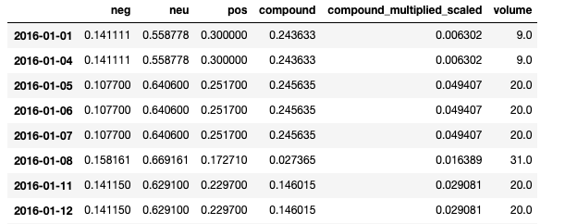
The obtained Preprocessed Data Frame after VADER

Slide 10
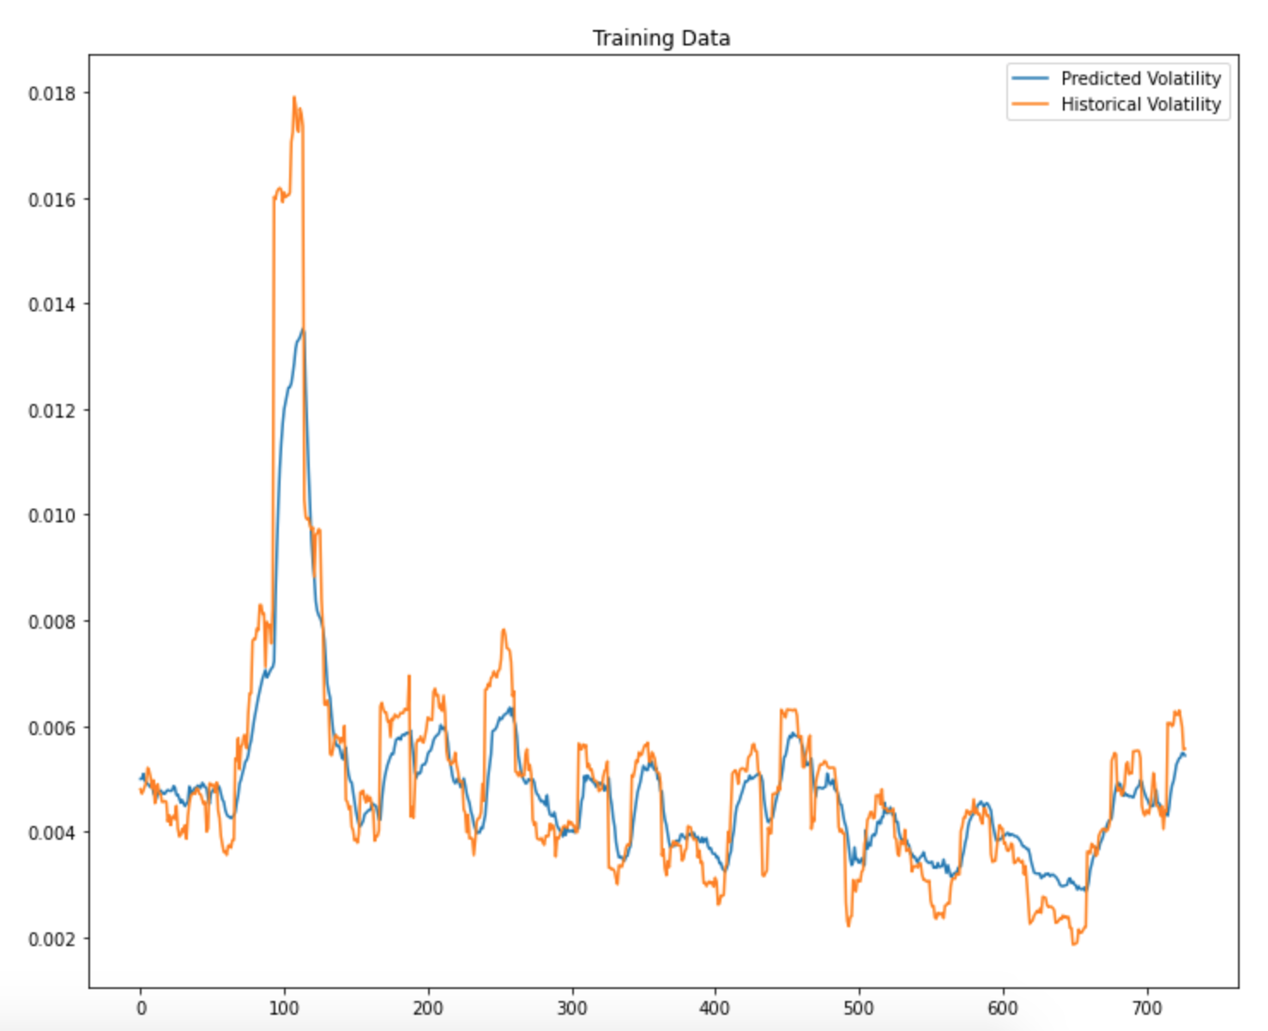
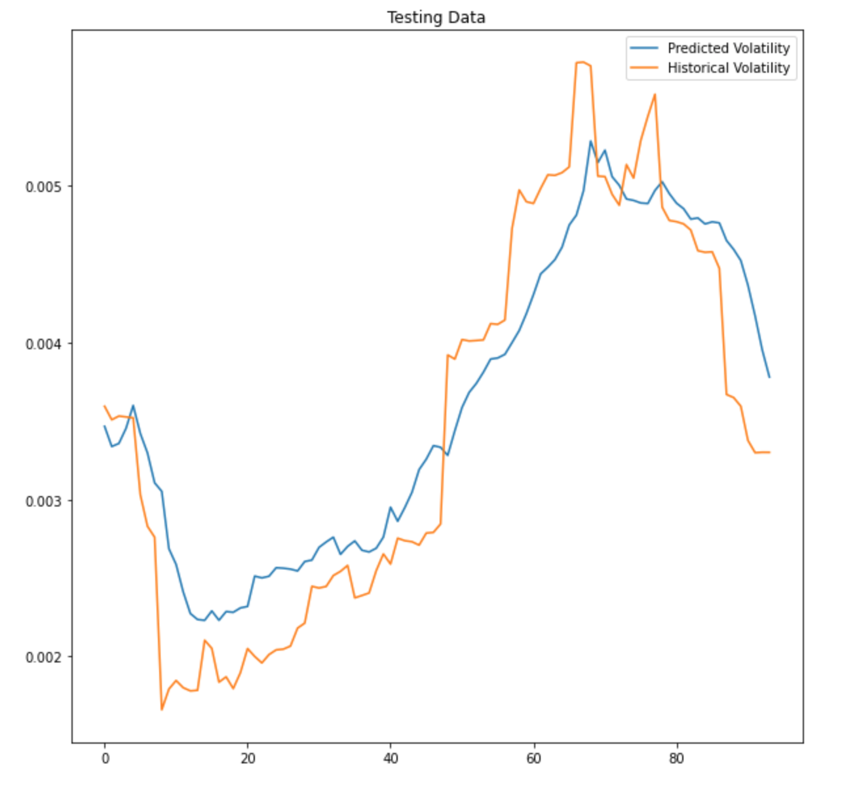
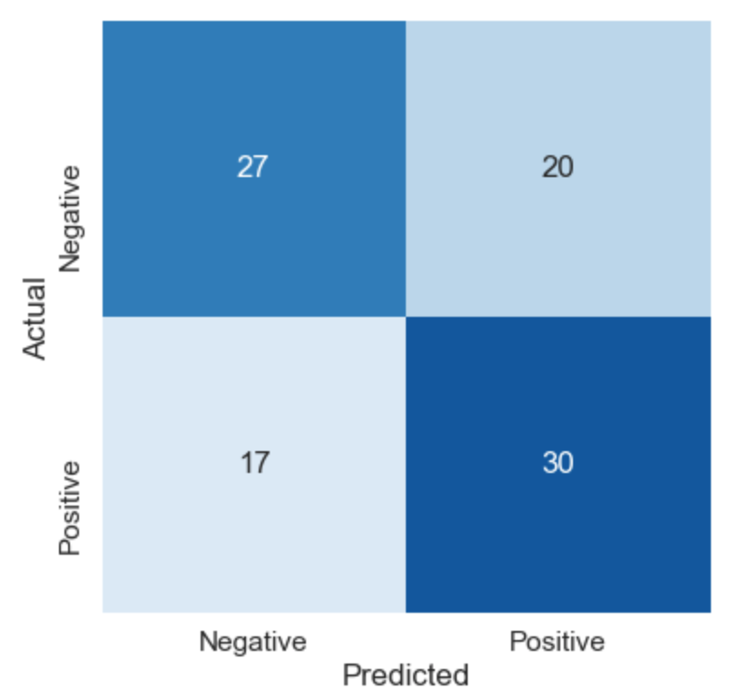
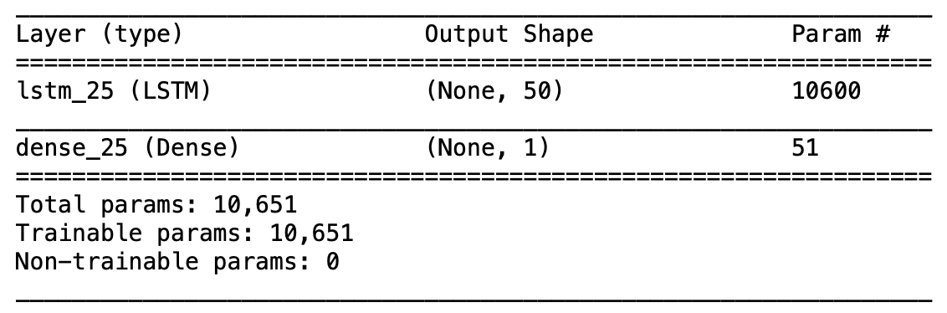
Volatility Prediction using LSTM Model

Slide 11
Conclusion & Future Work
We believe that Forex market is highly sensitive to news and opinions
Need a topic to relate news with a country
England = Brexit
VADER compound score had a great impact on the forecasting process.
One LSTM layer with 50 neurons was a good fit.
More layers tend to be more abstract features
We wanted to be better than Naive Approach (good beginning)
Accuracy of 60.3% in predicting if the volatility will be higher or lower than the previous day
Importance of Datasets
The first try with less data made a compound index useless
Future work:
Test with different Neural Network models
Increase the Database
Testing with live twitter data

Slide 12
References for the Project
[1] Calisir, Emre; Brambilla, Marco, 2020, "Twitter dataset about Brexit", https://doi.org/10.7910/DVN/KP4XRP, Harvard Dataverse, V1, UNF:6:5wutKhAU/2JSByEfCbI2Tg== [fileUNF]
[2] Patel, Nirali (2016). Analysing Stock Market Movements Using Twitter Sentiment Analysis. https://github.com/jaiminsanghvi/Analysing-Stock-Market-Movements-Using-Twitter-Sentiment-Analysis
[3] Al-Masri, Anas. (2019, Feb 13). Creating The Twitter Sentiment Analysis Program in Python with Naive Bayes Classification. Retrieved from https://towardsdatascience.com/creating-the-twitter-sentiment-analysis-program-in-python-with-naive-bayes-classification-672e5589a7ed?gi=d366a0a2bcd6
[4] Fatir,Abdul (2017, November 12). Twitter Sentiment Analysis. Retrieved from https://github.com/abdulfatir/twitter-sentiment-analysis
[5] Hutto, C.J. & Gilbert, E.E. (2014). VADER: A Parsimonious Rule-based Model for Sentiment Analysis of Social Media Text. Eighth International Conference on Weblogs and Social Media (ICWSM-14). Ann Arbor, MI, June 2014.

